Slide 1
Some thoughts on IoT
Geoff Huston
Chief Scientist, APNIC

Slide 2
Technology
Does technology change society, or do we develop and adopt technology to address society’s changes?

Slide 3

Technology
Technology
When Meng Tian invented the camel hair paintbrush in 250 BCE he did not invent calligraphy. He responded to a need in ancient Chinese society for more and higher quality written documents that could be produced faster
When Meng Tian invented the camel hair paintbrush in 250 BCE he did not invent calligraphy. He responded to a need in ancient Chinese society for more and higher quality written documents that could be produced faster

Slide 4

Technology
The most profound technologies are those that disappear. They weave themselves into the fabric of everyday life until they are indistinguishable from it...
- Mark Weiser 1991

Slide 5
Technology
Technology
The age of smartphones has left humans with such short attention spans that even a goldfish can hold a thought for longer” Leon Watson
The age of smartphones has left humans with such short attention spans that even a goldfish can hold a thought for longer” Leon Watson

Slide 6
So how should we look at the Internet of Things?
Is this merely a temporary consumer fad, destined to be replaced by the next cool technology item?
Or is this an instance of a profound technology change that redefines our role in our society, and will shape our everyday life for many years to come?

Slide 7
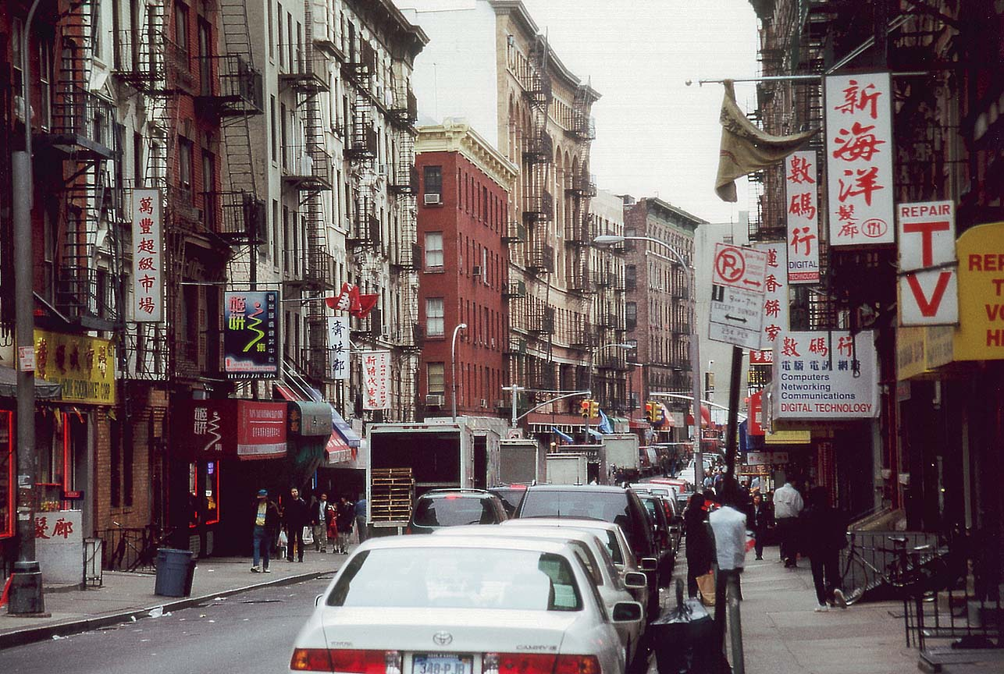
To try and answer this, lets try and put this question into some broader context of the evolution the computer and communications enterprise

Slide 8

Computers were esoteric high frontier research projects
1946 – Eniac – a numeric calculator

Slide 9

Then they became a “must have” business tool
1964 IBM 360 – commercial computing
1964: IBM 360

Slide 10

The Computing Evolutionary Path
Extravagant statements of techno power
1976 CRAY-1 – “super” computing

Slide 11

The Computing Evolutionary Path
But there was also the hobbyist market
1976 – Apple-1 “personal” computing
1976: Apple I

Slide 12

Consumer computers as a statement of design style
1984 – Mac

Slide 13
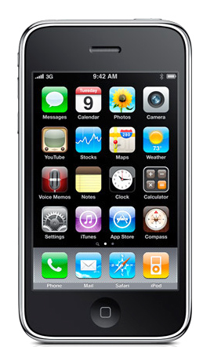
From Style to Mass Marketed Luxury Item
2007 – Apple’s iPhone

Slide 14
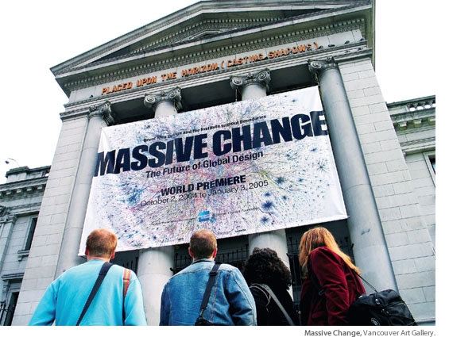

Slide 15
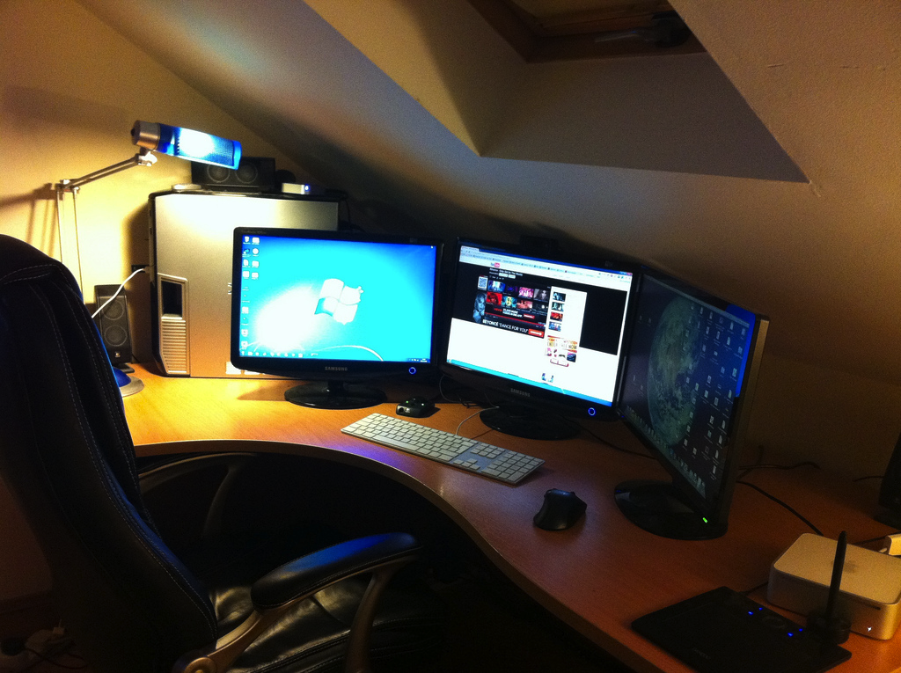
With desktop devices the Internet of computers was a dedicated activity
lighting
privacy
reliable power
large view screens
dedicated worktop
wired bandwidth
dedicated chair

Slide 16
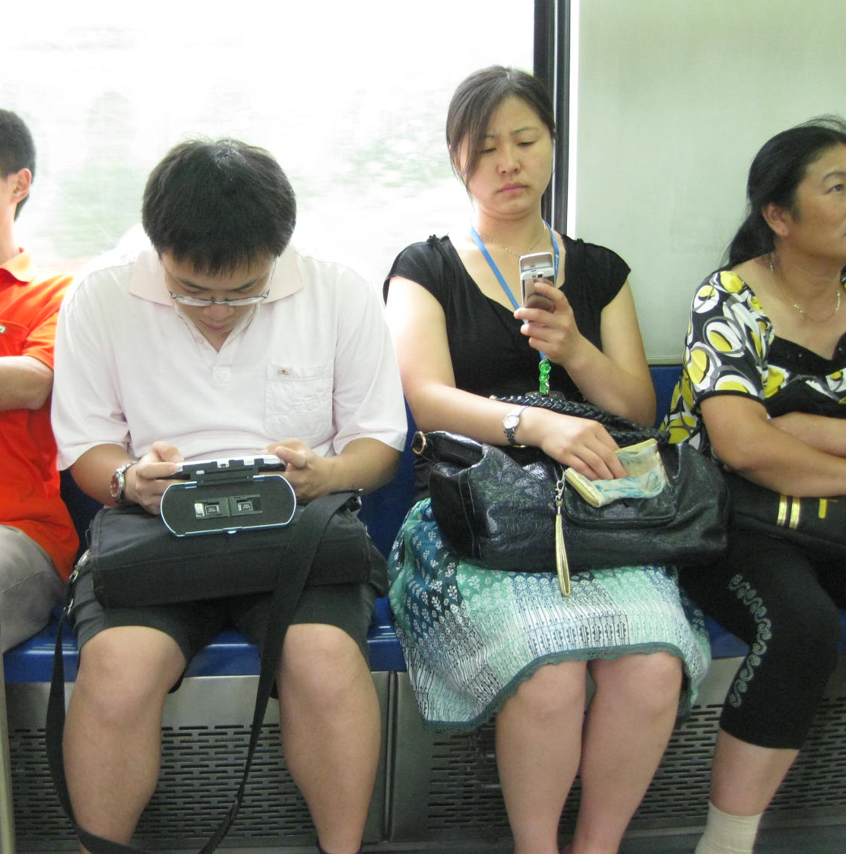
The Internet is now anywhere and everywhere
radio connectivity
Thumb
operated
hand sized
battery power
Its trivial, commonplace and blends into all our activities

Slide 17
Maybe its about the demise of the “traditional” computer
As dedicated “things” are replacing it

Slide 18
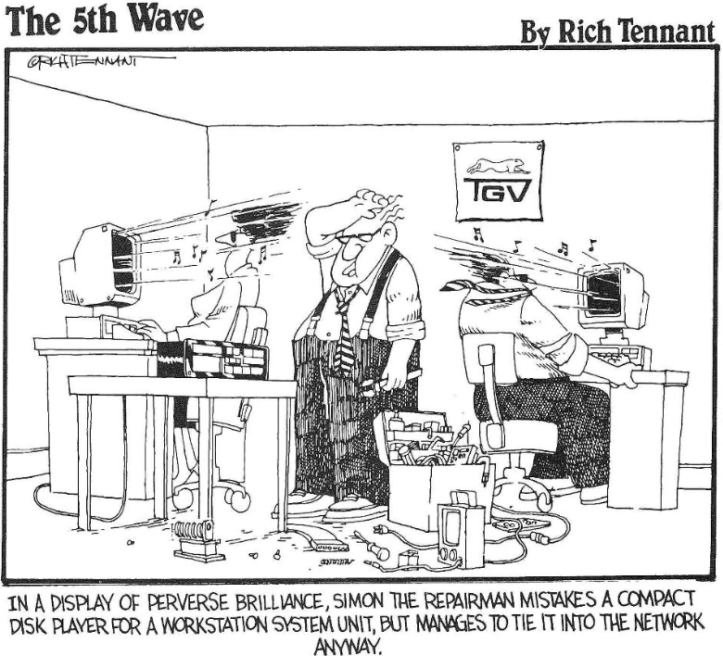
Connecting “things” to the Internet is nothing new
Simon Hackett’s Internet Remote Radio of 1990

Slide 19
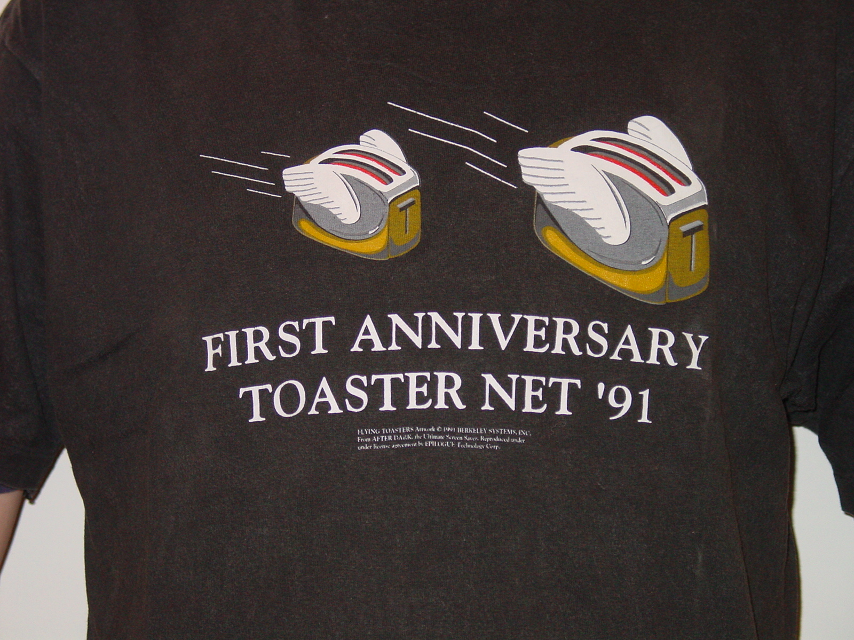
Connecting “things” to the Internet is nothing new
John Romkey’s Internet Toaster – Let them eat Toast!

Slide 20
The “old” IoT
The use of microprocessors to undertake simple tasks is about as old as the Intel 4004 and the Zylogics Z80 processor chips

Slide 21
This new IoT is just the old IoT with new chips!

Slide 22
The New IoT is just the Same Old IoT
And we are already living in a processing-dense world:
  A modern car has around 150 – 200 microprocessor-controlled systems, from the windscreen wipers, to the entry system, to engine control and all things in between
  Many / most consumer appliances have all turned to microprocessor control
  Industrial processes, logistics and inventory control, environmental monitoring all use various forms of embedded processing
So if this has been going on for years, why is IoT a hot topic today?

Slide 23
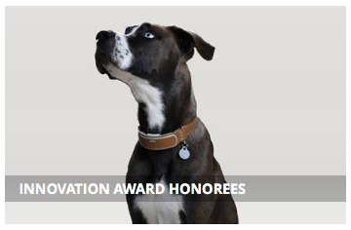
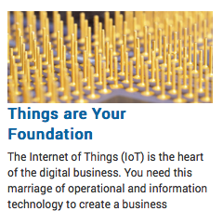
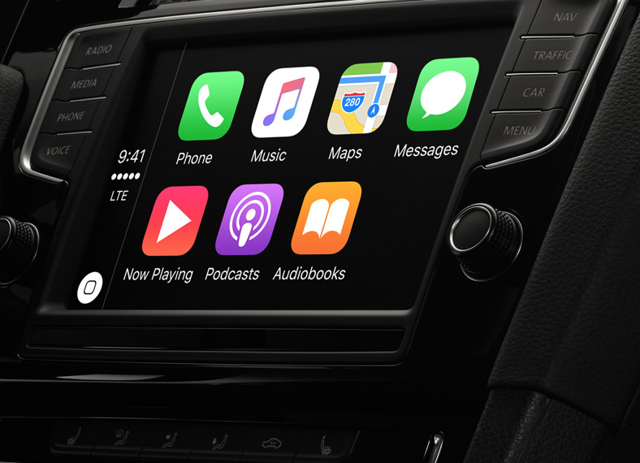
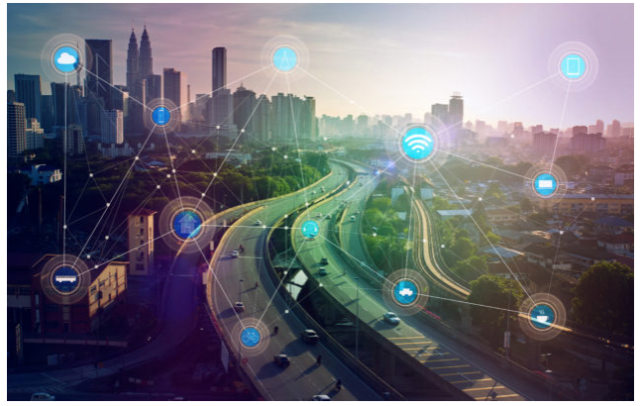

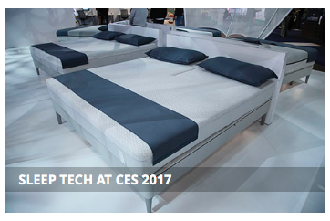
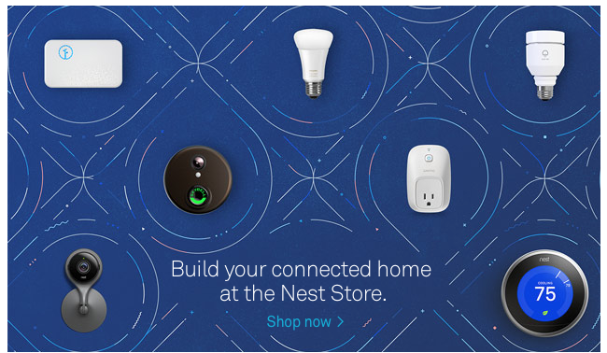
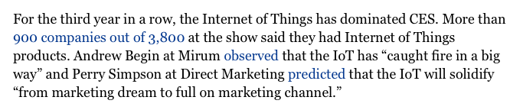
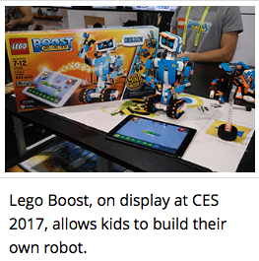
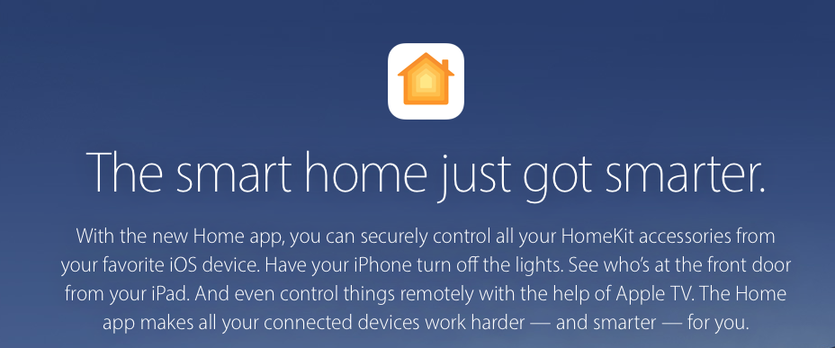
The Hype
Gartner Predictions
CES shows
Home Apps
Car Apps

Slide 24
IoT is …?
It is a generic term that encompasses a huge variety of application that have little in common other than a propensity to operate in an unmanaged environment
Its hard to talk about the IoT in anything other than highly generic terms

Slide 25
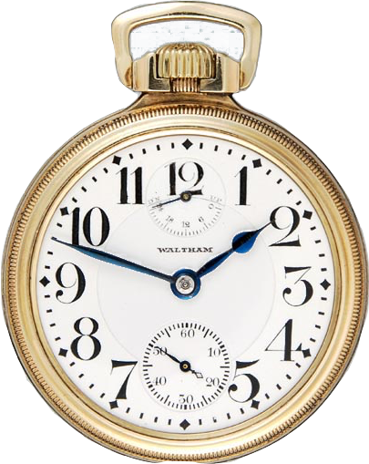
Why now?

Slide 26
Why now?
Low power, high capability silicon now dominates chip fabrication plants
  Saturation of the smart device market
  Full stream silicon production volumes requires some form of consumption model
Radio Technology: RFID, Bluetooth, WiFi, LTE
  Improvements in AD convertors is providing range and bandwidth to radio systems
  Protocol development provides ”seamless” connectivity
  i.e. Passports and Clothing Tags, Apple earbuds, Home controllers and similar
Actors seeking new markets
  5G for SIMs and wide area mobility
  Smart phone platform providers seeking to enter the car, home and work environments
  Industrial and process automation seeking to expand market reach

Slide 27
Why now?
Low power, high capability silicon now dominates chip fabrication plants
  Saturation of the smart device market
  Full stream silicon production volumes requires some form of consumption model
Radio Technology: RFID, Bluetooth, WiFi, LTE
  Improvements in AD convertors is providing range and bandwidth to radio systems
  Protocol development provides ”seamless” connectivity
  i.e. Passports and Clothing Tags, wireless earbuds, Home controllers and similar
Actors seeking new markets
  5G for SIMs and wide area mobility
  Smart phone platform providers seeking to enter the car, home and work environments
  Industrial and process automation seeking to expand market reach

Slide 28
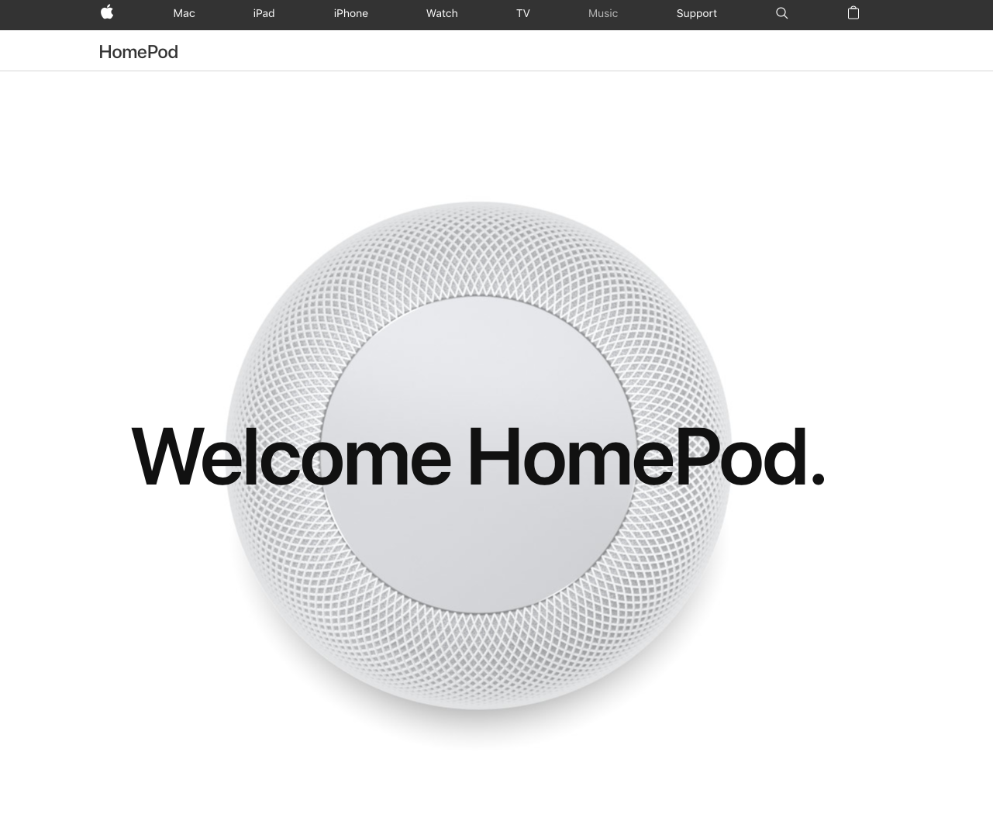

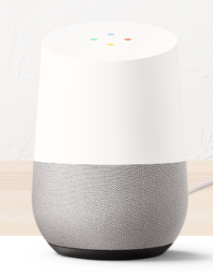
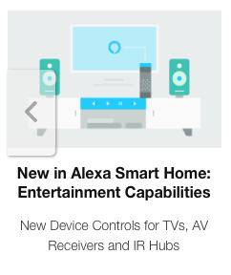
Why now?
Low power, high capability silicon now dominates chip fabrication plants
  Saturation of the smart device market
  Full stream silicon production volumes requires some form of consumption model
Radio Technology: RFID, Bluetooth, WiFi, LTE
  Improvements in AD convertors is providing range and bandwidth to radio systems
  Protocol development provides ”seamless” connectivity
  i.e. Passports and Clothing Tags, Apple earbuds, Home controllers and similar
Actors seeking new markets
  5G for SIMs and wide area mobility
  Smart phone platform providers seeking to enter the car, home and work environments
  Industrial and process automation seeking to expand market reach

Slide 29
Why now?
Because we have saturated our traditional markets for technology and the production capacity is being redirected to new opportunities
  PC sales volumes are plummeting
  Smartphone sales are now peaking
  The computer technology industry is seeking to use its existing capability to provide new product to high volume markets
  Which means looking at low unit margin very high volume opportunities by adding ”smart” network centric interfaces and controllers to existing devices and functions

Slide 30
The opportunities
“smart” lighting - e.g. Philips
“smart” home appliances and networks - e.g. Miele
“smart” power management
”smart” labels for retail
“smart” traffic control
“smart” image analysis
“smart” video surveillance
Almost anything else that uses the word “smart”

Slide 31
The Variety of Life
IoT
It’s a set of discrete applications that have highly divergent requirements:
  Radius of connectivity varies from mm to kilometers
  Bandwidth varies from bits to gigabits per second
  Data volumes vary from bytes to petabytes
  Connectivity models may be push or pull
  Connectivity may be ad-hoc relays to dedicated wired
  Transactions may be unicast, multicast or anycast in nature
  Applications include sensing and reporting, command and control, adaptation and interfacing
There is little that these environments have in common, except maybe a common underlying gene pool!

Slide 32
The IoT Gene Pool
Unix Platform
  Its small, its ubiquitous, its well understood, its cheap, its open source without onerous IPR constraints, it has a massive set of application libraries
  Customised micro kernels are risky, expensive and rarely necessary

Slide 33
The IoT Gene Pool
IP Comms
  Its small, its ubiquitous, it scales, its well understood, its cheap, its open source without onerous IPR constraints, and everyone speaks it!
  But which version of IP?

Slide 34
IPv4 and IoT
The “conservative” option for IP in this environment
  Ubiquitous support across the entire deployed Internet
  Well understood protocol behaviour
  Widely available APIs
  Of course it should also be useful to factor in NATs in IPv4:
  Push model where the “thing” pushes data to a rendezvous point rather than a constant pollable model of “pull” access
  Pull and Feeder models work behind NATs using relays and/or ALGs split the primary feed from the propagation of the data

Slide 35
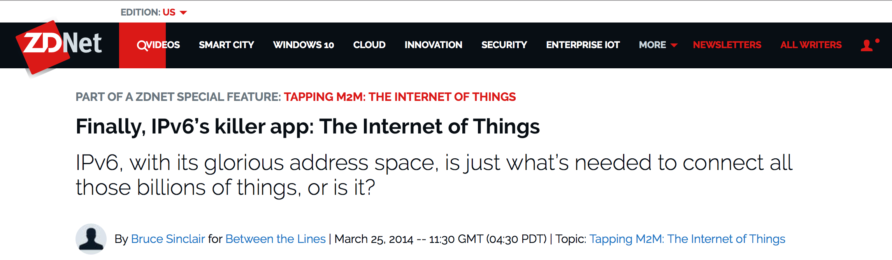
IPv6 and IoT
It’s the “killer app” for IPv6
But the numbers suggest otherwise:
  7B connected “devices” on today’s IPv4 Internet, plus a further 7B – 20B (*) conventional PC and smart devices
  2.8B announced IPv4 addresses
  1.5B “occupied” IPv4 addresses
  We can probably push this model harder!
* https://www.statista.com/statistics/471264/iot-number-of-connected-devices-worldwide/

Slide 36
“Thing” Behaviour
Pull:
Device is always connected and interrogated by external agents
  A model of polling or feed subscription where the device maintains information that can be polled by an external agent
  This requires an public IP address + Port
  It also requires a highly robust core implementation that is resistant to attack
  It also requires some considerable thought on the authorization model
    Device is configured to authorize users and/or
    Device uses a third party auth server
  Commonly seen in web cams and other continuous monitoring applications (though it’s not necessarily required)

Slide 37
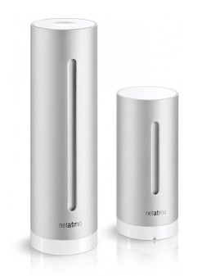
Pull vs Push
Push:
Intermittedly connected and interrogated via external agents
  Device pushes data to some data collection agent
  Limited connection requirement
  This behaviour NAT ”friendly” as the device is the client and the collection point is the server
  External access via the data collection agent, not the device
  Does not require dedicated addressing outside of the local context
  This limited access model facilitates defensive measures, including encrypted communications to the device’s agents and preventing all third party connections
  And such devices probably should be behind a NAT in any case! (e.g. cameras)

Slide 38
Security

Slide 39
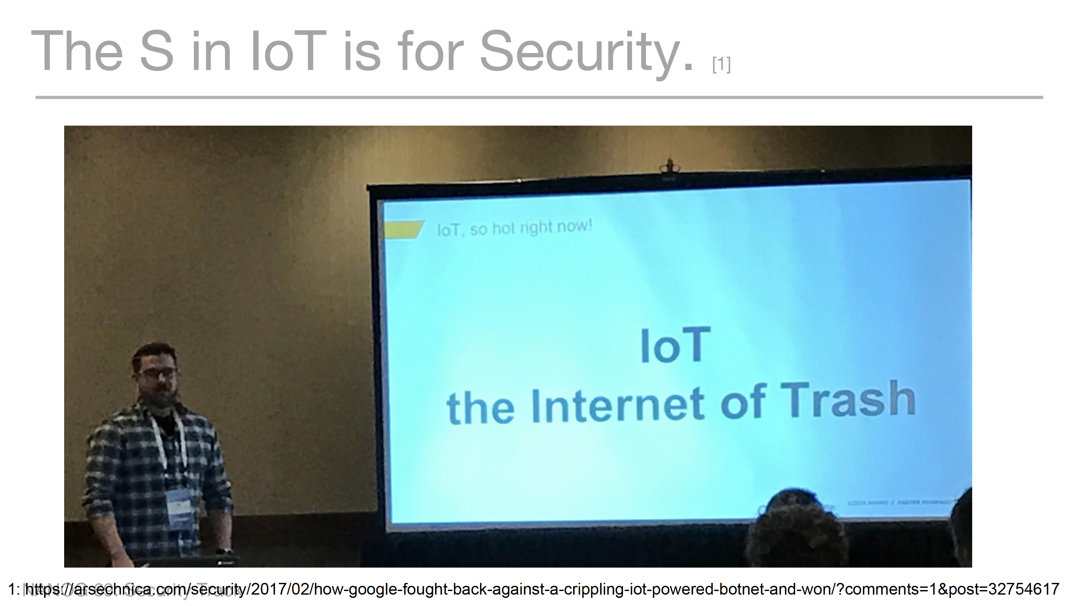
Seen at NANOG 69…

Slide 40
Security
Interesting quote ...
“At last count I have about 43 devices on my LAN, with less than a third running an OS that I can actually interact with. The rest are embedded systems that get updated (hah!) by the vendors at their whim. Easily two-thirds would 'phone home' to somewhere at various times. About 7 have external access without explicitly setting port-forwarding.
Of course, my router monitors and reports on all outbound traffic - but do I actively look at it? I should. But I don’t. And of course everything we value on our LAN we protect and encrypt end-to-end and at-rest as the LAN is actually occupied by foreign devices with unknown network capability... sure we encrypt absolutely everything...”

Slide 41
An Internet of Stupid Things
Insanely
We keep on seeing the same stupidity again and again:
Devices with the telnet port open
Devices with open DNS resolvers on the WAN side
Devices with open NTP / SNMP / chargen etc
Devices with the same preset root password
Devices using vulnerable libraries that are susceptible to root kit exploitation

Slide 42
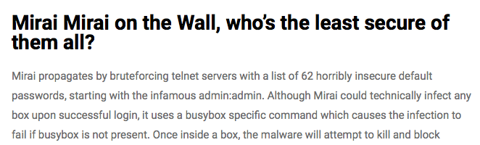
An Internet of Stupid Things
Insanely
We keep on seeing the same stupidity again and again:
Devices with the telnet port open
Devices with open DNS resolvers on the WAN side
Devices with open NTP / SNMP / chargen etc
Devices with the same preset root password
Devices using vulnerable libraries that are susceptible to root kit exploitation
https://www.malwaretech.com/2016/10/mapping-mirai-a-botnet-case-study.html

Slide 43
An Internet of Stupid Things
Insanely
We keep on seeing the same stupidity again and again:
Devices with the telnet port open
Devices with open DNS resolvers on the WAN side
Devices with open NTP / SNMP / chargen etc
Devices with the same preset root password
Devices using vulnerable libraries that are susceptible to root kit exploitation
And this simple technique was used to mount a 1 Tbps attack!
https://www.malwaretech.com/2016/10/mapping-mirai-a-botnet-case-study.html

Slide 44
The Internet of Stupid Things
How do you perform field upgrades of otherwise neglected and unmanaged devices
What’s the economics of incenting field upgrades from the manufacturer?
Who is responsible for broken “things”?

Slide 45
The Internet of Stupid Things
Is this stupidity even avoidable?
  The bleak picture is maybe not!
  In a price sensitive market where system robustness and quality is largely intangible where is the motive to maintain high quality code?
  How can a consumer tell the difference in the quality of the software, in term of its robustness and security of operation?
  high clock speed industry + commodity components + low margin
  = market failure for IoT Security

Slide 46
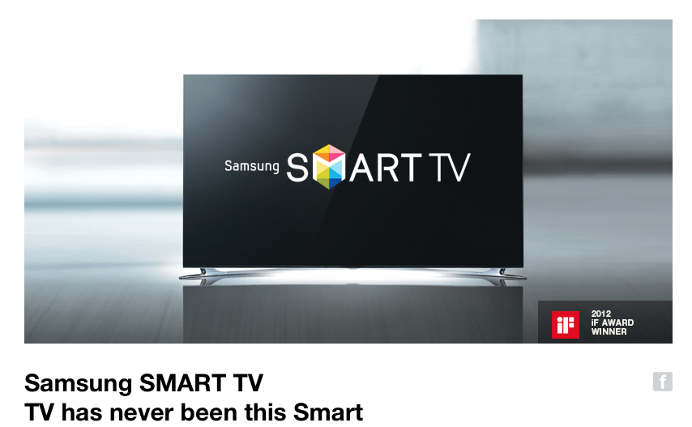
Privacy

Slide 47
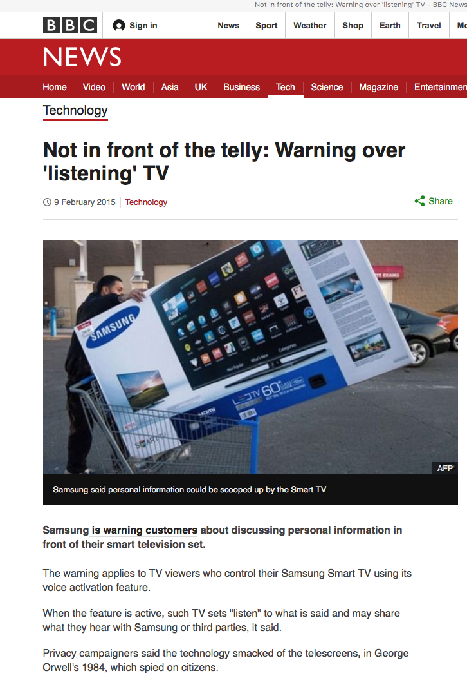
Privacy

Slide 48

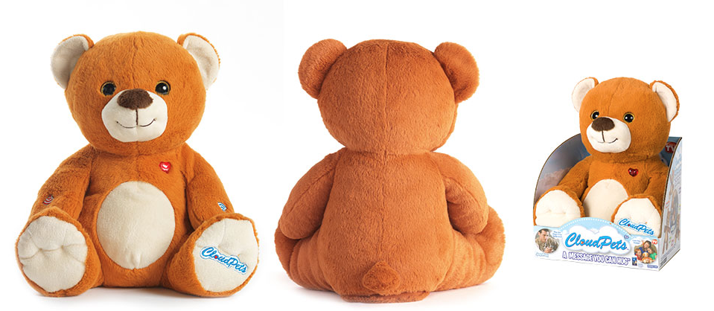
Privacy

Slide 49
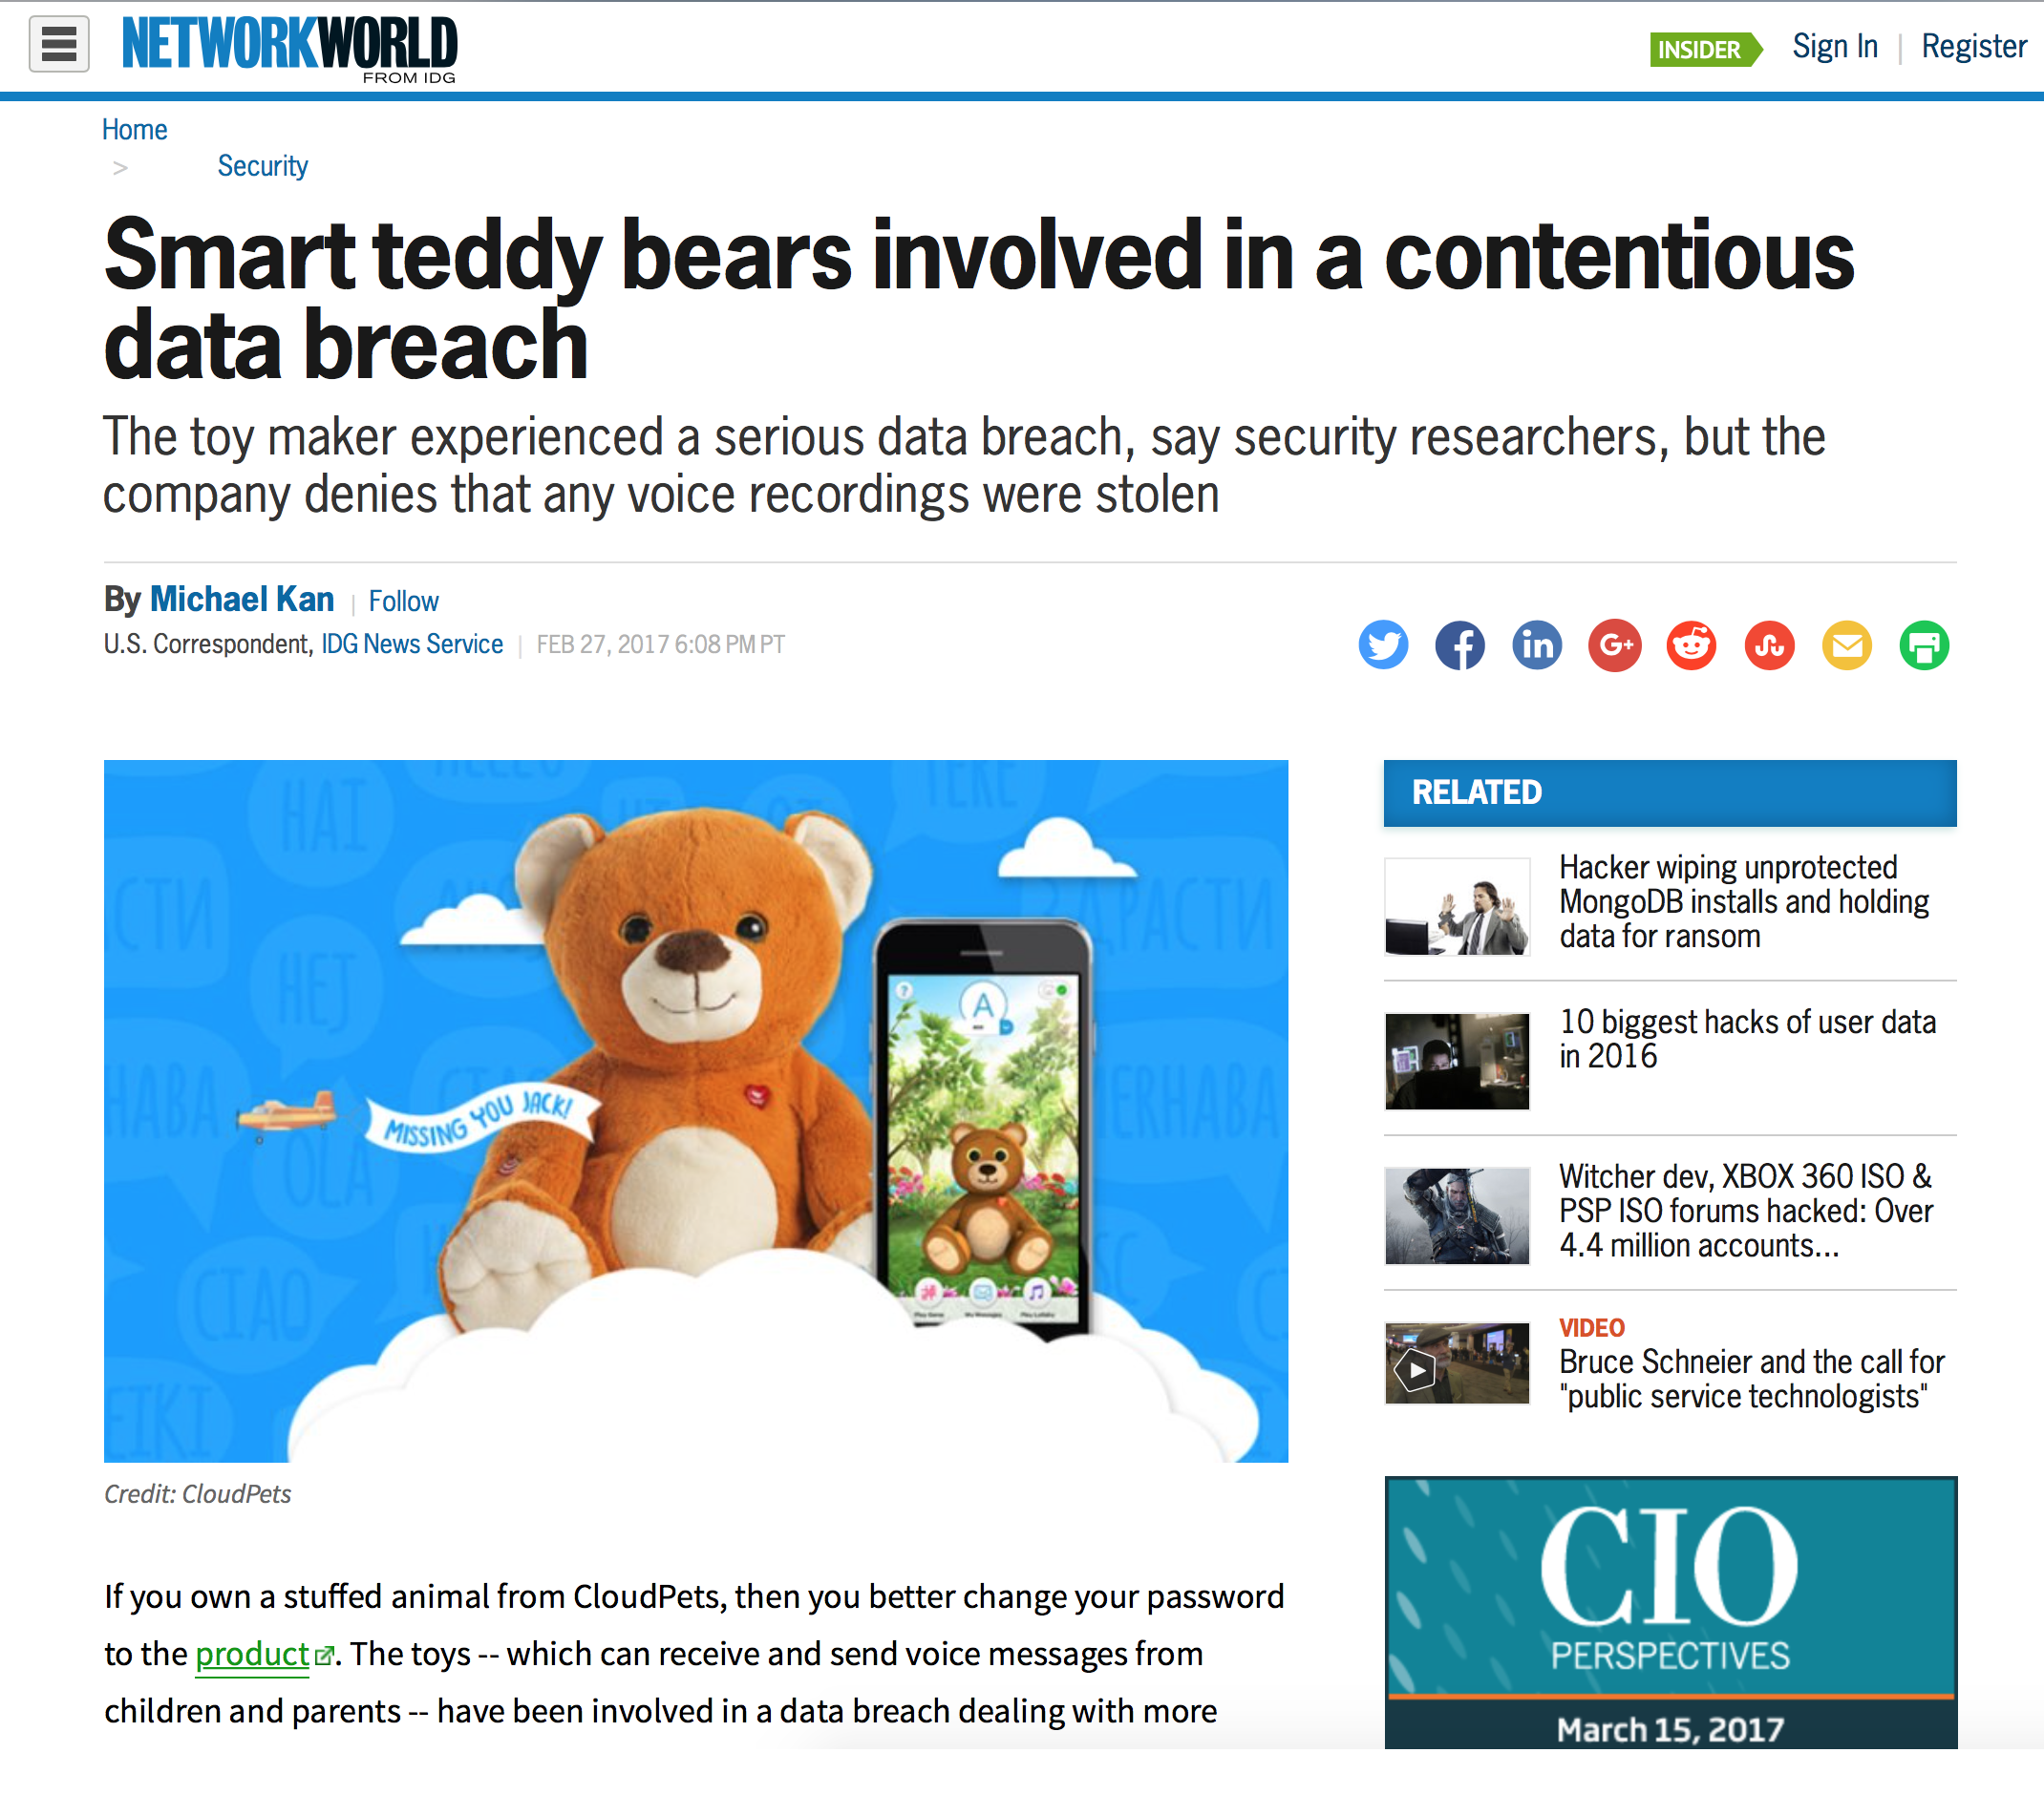
Privacy

Slide 50
Some things we can’t tell yet
Will we standardize the IoT space or will it continue to be a diverse set of mutually incompatible devices?
Will the market consolidate to be dominated by a small number of providers and their pseudo-open proprietary architectures?
When will the IoT embrace IPv6, if ever?
Will the IoT market ever discriminate on quality and robustness?
How do we manage the risk of coercion of these devices?

Slide 51
But there are some things you can count on…
The volumes are already huge, and they’re growing
  “Things” already outnumber everything else on the Internet
Comprehensive security is unachievable
Privacy is now an historical concept
Digital pollution is pervasive
We now have an Internet that is a largely chaotic and definitely hostile environment

Slide 52
And one more thing we can count on…

Slide 53
And one more thing we can count on…
It will definitely get a whole lot worse than it is today!

Slide 54
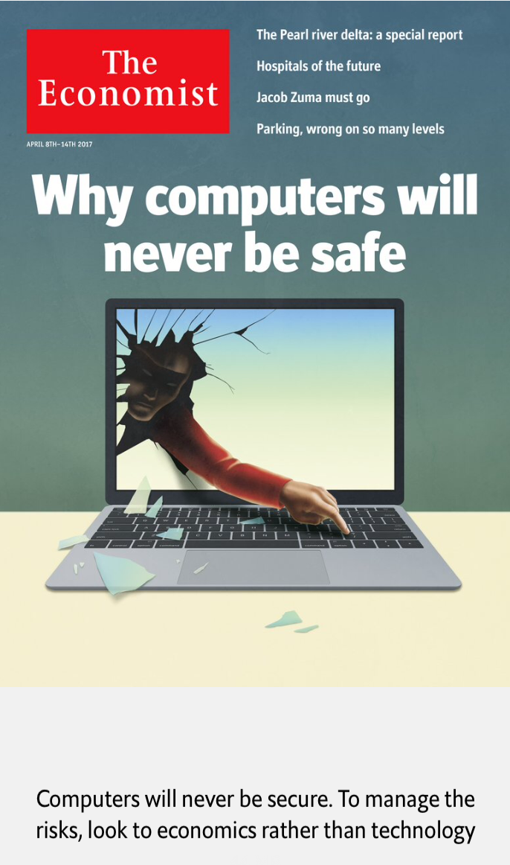
It’s a tough problem…
A rather bleak prognosis from the
Economist in April this year – don’t look for technology to improve this rather disturbing situation!
They suggest looking at economics and markets to try and address this problem…

Slide 55
But markets may not help either…
"The market can't fix this because neither the buyer nor the seller cares.
The owners of the webcams and DVRs used in the denial-of-service attacks don't care. Their devices were cheap to buy, they still work, and they don't know any of the victims of the attacks.
The sellers of those devices don't care: They're now selling newer and better models, and the original buyers only cared about price and features.
There is no market solution, because the insecurity is what economists call an externality: It's an effect of the purchasing decision that affects other people. Think of it kind of like invisible pollution."
https://www.schneier.com/blog/archives/2017/02/security_and_th.html

Slide 56
Is this another of those massive challenges of our time?
We just don’t have the tools to figure out how to stop this environment being fatally overrun by these devices:
  We can’t improve their quality
  We can’t keep building ever larger DOS barriers
  We can’t regulate behaviours of the equipment, their makers or distributors

Slide 57
Why will this get any better?

Slide 58
It wont.

Slide 60
Thanks!

